Slide 1
Student record management system
Section : N
Submitted by:
Afsa Atiq (693)
M Umer Shahzad (297)
M Hassaan (677)
Submitted to:
Sir Asad ullah Khalid

Slide 2
Introduction
Overview of the program and its purpose.
Program flowchart
Conclusion
QnA
Login/ Signup

Slide 3
Program flowchart
Flowchart :
Start
Display menu
Switch
state
Function call
Exit

Slide 4
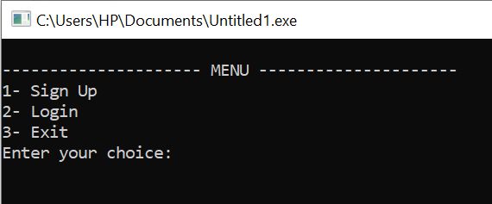
Login / SignUp
Objective:
Implement a basic user authentication system with options for login, signup, and password recovery.
Console Screen:

Slide 5
Menu Options
Add Record
Display Records
Modify Record
Delete Record
Logout

Slide 6
Add Record Function
Functionality:
Takes user input for name, roll number, marks, section, and semester.
Appends the record to the file
Code example:
Student newStudent;
cout << "Enter name: ";
cin.ignore(); // Clear the input buffer
cin.getline(newStudent.name, sizeof(newStudent.name));

Slide 7
Display Records Function
Functionality:
Reads records from the file and displays them in a tabular format.
Code example :
while (inFile >> currentStudent.name >> currentStudent.rollNo >> currentStudent.marks>> currentStudent.section >>currentStudent.semester) {
cout << setw(20) << currentStudent.name << setw(15) << currentStudent.rollNo << setw(10) << currentStudent.marks
<< setw(10) << currentStudent.section << setw(10) << currentStudent.semester << "\n";

Slide 8
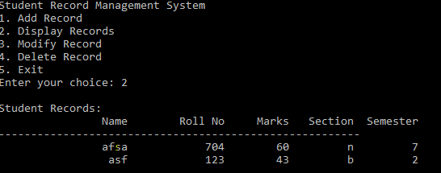
Console Representation

Slide 9
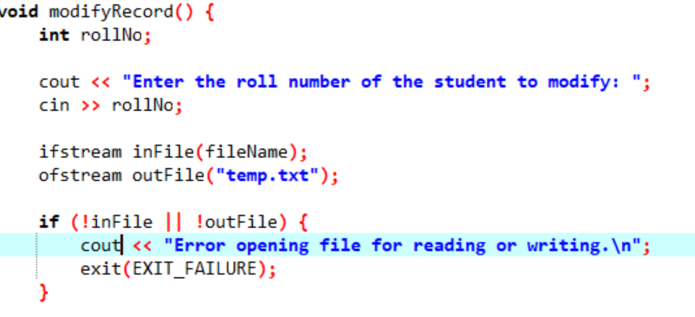
Modify Record Function
Functionality:
Takes a roll number as input and allows the user to modify the corresponding record.
Example :

Slide 10
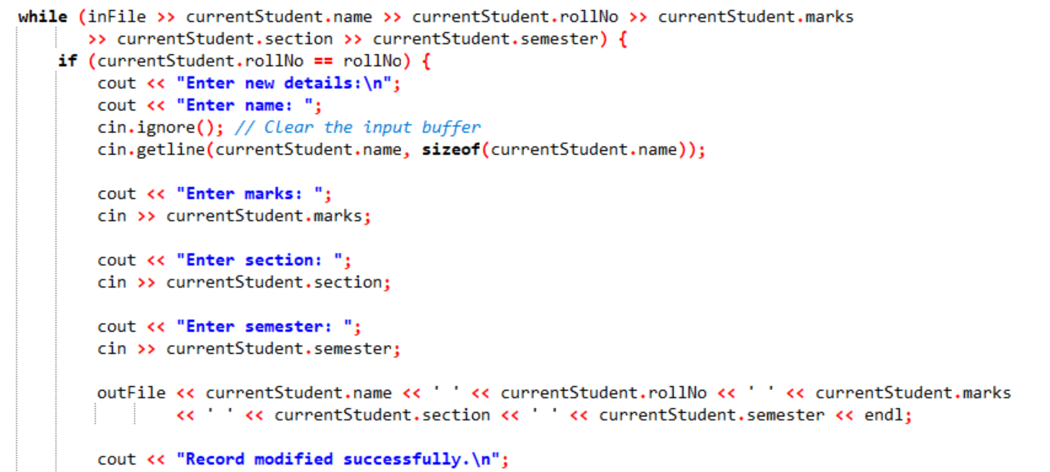

Slide 11
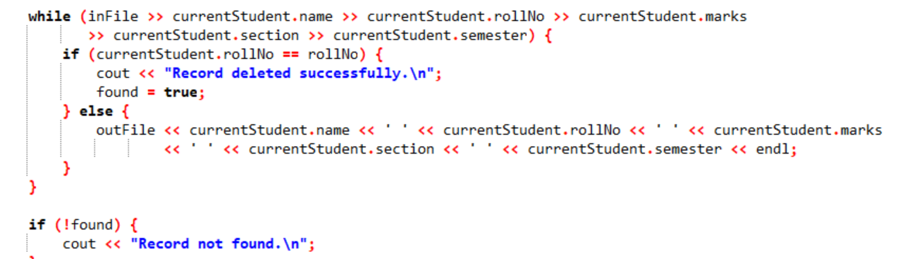
Delete Record Function
Functionality:
Takes a roll number as input and deletes the corresponding record.
Code example :

Slide 12
Example record
Name: John Doe
Roll No: 101
Marks: 85.5
Section: A
Semester: 2

Slide 13
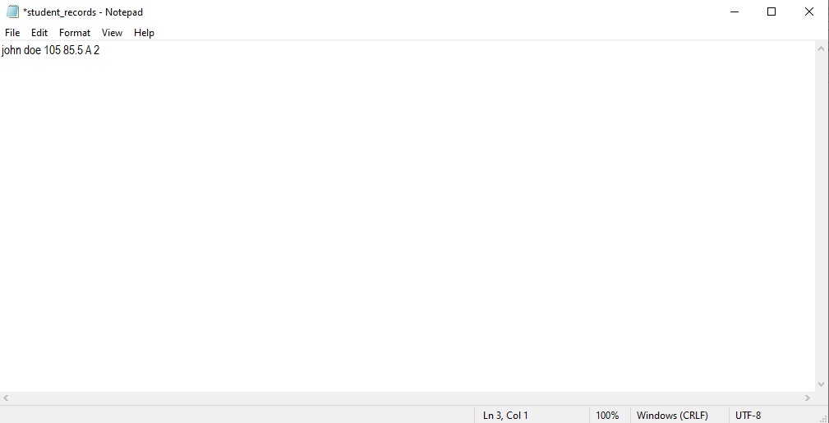
File handling
The program utilizes file handling to store and retrieve student records.
The file (student_records.txt) is opened in append mode for adding record.
Diagram:
.

Slide 14
Conclusion
Easy-to-use & user Friendly interface.
Records are securely stored in a text file for lasting accessibility.
Comprehensive features include adding, displaying, modifying, and deleting student records.
C++ code is modular and well-organized, enhancing readability and maintainability.
Clear prompts and instructions ensure a smooth and user-friendly experience.
The program offers a basic user authentication system.
Login & Sign Up feature

Slide 15
Q&A
Any question and doubt…!

Slide 16
Success is not just about making the right choices; it's about learning from the wrong ones.
Keep coding with passion.
Thank you!"

